Slide 1
LIBS 7001, Week 4 – COMP 5
Thanks for your Analysis Essays!
Comparison and contrast
  Lecture on basic principles & forms of comparison
  Seminars
    “Mother Tongue”
    “Pandora’s Click”
  Discussion of paired texts “Infant Joy” & “Infant Sorrow”
  (time permitting) organizing a comparison essay
Notes:
LIBS 7001

Slide 2
Next Week: Causation
we’ll begin prep. for the midterm
seminars on
  “Game Theories”
  “Speech of Aristophanes” (read this 2x)
readings as noted in course outline, including handout on causation types (in the syllabus)

Slide 3
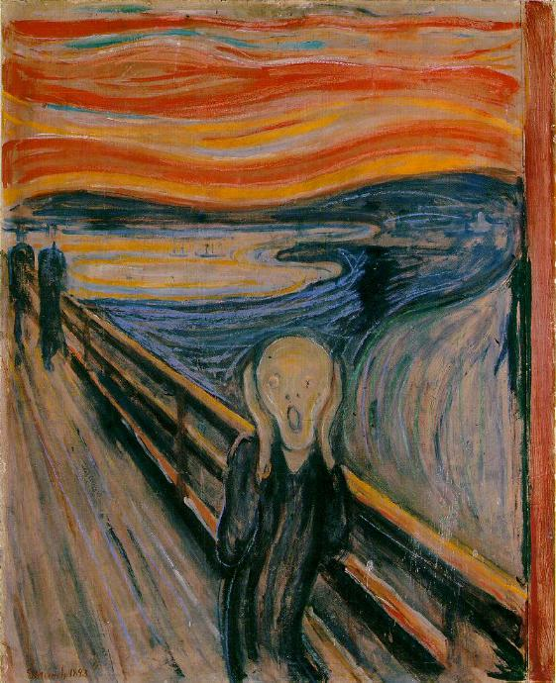
LIBS 7001 Midterm In-Class Exam is on October 19, Wk. 7
We’ll do exam review next week, because class is cancelled the week before the exam, Monday Oct. 12, for the Thanksgiving holiday.
Notes:
LIBS 7001

Slide 4
Using Comparison & Contrast
identify, discuss, use, evaluate concepts and techniques of comparison (a.k.a. “comparison & contrast”), including
  block and alternating methods
  basis of comparison / points of comparison
  logical & rhetorical comparison
  analogy, parable, and parody
identify and evaluate elements of comparison in sample essays / visual texts
(time permitting – from separate lecture notes) organize an essay comparing two texts
Notes:
LIBS 7001

Slide 5
What is Comparison?
shows similarities & differences between and among people, things, ideas.
Complex comparisons can examine
  similarities and differences among many subjects
  many similarities & differences among a few subjects
  many similarities & differences among many subjects
Examples
  “comparison” lists when shopping online at London Drugs & other store
    CBC news item, 24 Sept. 2009: “Poll highlights differences in young Canadians and Americans”
Notes:
LIBS 7001

Slide 6
How is comparison used?
SSW, Ch. 12
helps us choose between alternatives
acquaints us with unfamiliar things
education and work examples: comparing
  several phone systems
  candidates for a job
  patient’s condition before and after treatment
  one essay to another
  a number of GPS products
Notes:
LIBS 7001

Slide 7
Developing a Comparison
Items compared must share some common ground
  many possible points of comparison: e.g., fences & windows; innocence and experience
  no meaningful basis for comparison: chicken and charcoal
  (you decide): golfer and car; guacamole & Guadalajara
Any valid comparison presents many possibilities
Successful comparisons use details that are
  well-chosen
  sufficiently developed
Notes:
LIBS 7001

Slide 8
Basis of Comparison
Comparison helps you and your reader better understand
  the things you’re comparing
  the more general concept that’s the basis for the comparison
basis of comparison: the common element in terms of which you will compare something
  forces you to consider your own ideas and assumptions
Notes:
LIBS 7001

Slide 9
Organizing a Comparison
Two main methods or patterns of comparison:
  block: one subject presented fully, then the other / others
  alternating (point by point): different aspects of subjects compared sequentially
Use a table to gather basic information
Notes:
LIBS 7001

Slide 10
Patterns / Methods of Comparison
Block Pattern
present everything about one subject before discussing everything about other subjects
useful when developing only a few main points about a few subjects (short texts), without extensive quotes or evidence
Alternating Pattern
compare subjects one aspect at a time, point by point
better for essays over 500 words and for detailed comparisons
Notes:
LIBS 7001

Slide 11
Comparison: Types / Extended
Consistent with the bi-polar approach of western culture, rhetoricians sometimes distinguish between two types of comparison:
  logical / objective / denotative: often used for explaining – but keep it up to date: The Internet is an information highway….
  rhetorical / subjective / connotative: often used for persuading: This candidate’s like an old horse who’s run too many races….
Other types of extended comparison are parody, analogy, and parable.
Notes:
LIBS 7001

Slide 12
Analogy and Parable
Both often used to explain a new, complex idea in terms of something the audience knows.
  Electrical current is like a river…
    explanation can be extended for many sentences using this analogy
Parable (from Gr. parabole, a comparing, or throwing alongside): a short, fictitious narrative from which a human truth, or moral or spiritual lesson, can be drawn
Notes:
LIBS 7001

Slide 13
Parody
from the Grk., meaning: “a song alongside of”
discourse in which the style and language of one author or text is imitated or mimicked, usually for comic effect
BUT parody can also have a serious, critical purpose: can use humour to create insight
  parodies of Münch’s The Scream
  The Sopranos / Analyze This (The Godfather / Goodfellas)
  Goodfellas (most “westerns” / “cowboy” movies)
  Jon Stewart & The Daily Show (most TV news shows)
Notes:
LIBS 7001

Slide 14
"I was walking along the road with two friends. The sun was setting. I felt a breath of melancholy - Suddenly the sky turned blood-red.
I stopped, and leaned against the railing, deathly tired - looking out across the flaming clouds that hung like blood and a sword over the blue-black fjord and town.
My friends walked on - I stood there, trembling with fear. And I sensed a great, infinite scream pass through nature.”
Edvard Munch’s journal ,
22 January 1892
The Scream, 1893
Notes:
LIBS 7001

Slide 15
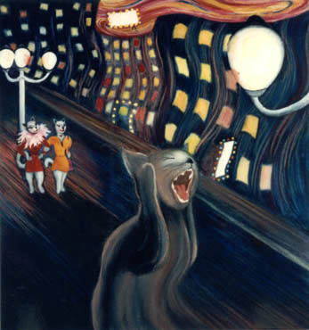

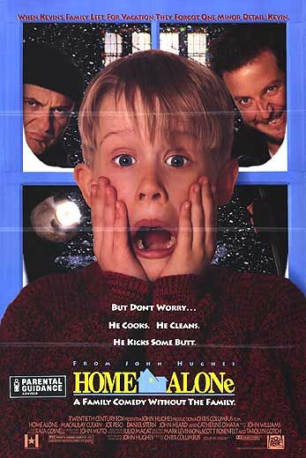
Visual Parody
http://www.thecatgallery.com/the_scream_Munch_cat_print.html
http://www.gbposters.com/image/image/1390/FP1334.jpg
http://www.impawards.com/1990/home_alone_ver2.html
Notes:
LIBS 7001

Slide 16
Analogy
Analogy: (from Gr. analogos, a due ratio)
  an extended metaphor or simile
  compares two quite different things or activities for the purpose of explanation
  often used in science writing
    “The atmosphere of the earth acts like a window. . . .[that] helps keep our planet at a comfortable temperature. . . .” (del Ray, qtd in SSW, p. 261)
    A mind is like a parachute…
Limit use of analogies; don’t draw them out to the point of absurdity.
Notes:
LIBS 7001

Slide 17
Parable Examples
(1) “What shall we say the Kingdom of God is like?” asked Jesus. “What parable shall we use to explain it? It is like this. A man takes a mustard seed, the smallest seed in the world, and plants it in the ground. After a while it grows up and becomes the biggest of all the plants. It puts out such large branches that the birds come and make their nests in its shade.” (NT, Mark, 4, 30-34)
Notes:
LIBS 7001

Slide 18
(2) A man traveling across a field encountered a tiger. He fled, the tiger after him. Coming to a precipice, he caught hold of the root of a wild vine and swung himself down over the edge. The tiger sniffed at him from above. Trembling, the man looked down to where, far below, another tiger was waiting to eat him. Only the vine sustained him.
Two mice, one white and one black, little by little started to gnaw away at the vine. The man saw a luscious strawberry near him. Grasping the vine with one hand, he plucked the strawberry with the other. How sweet it tasted! (P. Reps, Zen Flesh, Zen Bones)
Notes:
LIBS 7001

Slide 19
For the comparison readings / viewings, consider the following questions:
What is being compared? contrasted? (note: many points of comparison can exist in one "text")
What are the main ideas conveyed by the texts/visuals?
How does the authors' use of comparison/contrast convey the main idea(s)?
Are the comparisons balanced, fair, and clear? Give evidence for your view.
How do your own background and experience contribute to your assessment of the articles? What process did you go through to try to transcend the limitations of your perspective and achieve a balanced interpretation of these texts?
Notes:
LIBS 7001

